Slide 1
Welcome to liwaa’s portfolio Website presentation!

Slide 2
Overview of the portfolio
This is an introductory website for myself
Meant to provide potential employers and any site visitors in general my foundational knowledge in creating a website about myself
Help to get my feet in the water to become more familiarized with creating any website in general by following certain structures, aligning components in a certain manner, etc

Slide 3
Intro to the sitemap
I’ve included a sitemap which shows a quick overview of the structure of my website!
It’s should be able to explain to any new site visitor in a brief manner what is available to them and how they can access it by navigating from certain pages on the website!

Slide 4
My sitemap

Slide 5
Sitemap explanation
So as seen on the previous slide, visitors would first find themselves on the homepage of the website.
Throughout the website, one constant feature that’s available to the user would be the navbar (which is explained in further details in the upcoming slides)
The home, portfolio, blog, about me and contact me pages are accessible to one another through the navbar
The blog posts are available to access by initially navigating to the blog page!

Slide 6
List of components used
1. The navbar (contains links to the home, portfolio, blog, about me and contact me pages!
Have it fixed at the bottom of the page so it can be available regardless of where you would be scrolling in the page
2. The header for each page (same font, similar sizes, maybe different colours)
3. The image component (placing a different number of images on different pages in the website to suit whatever is needed)
4.

Slide 7


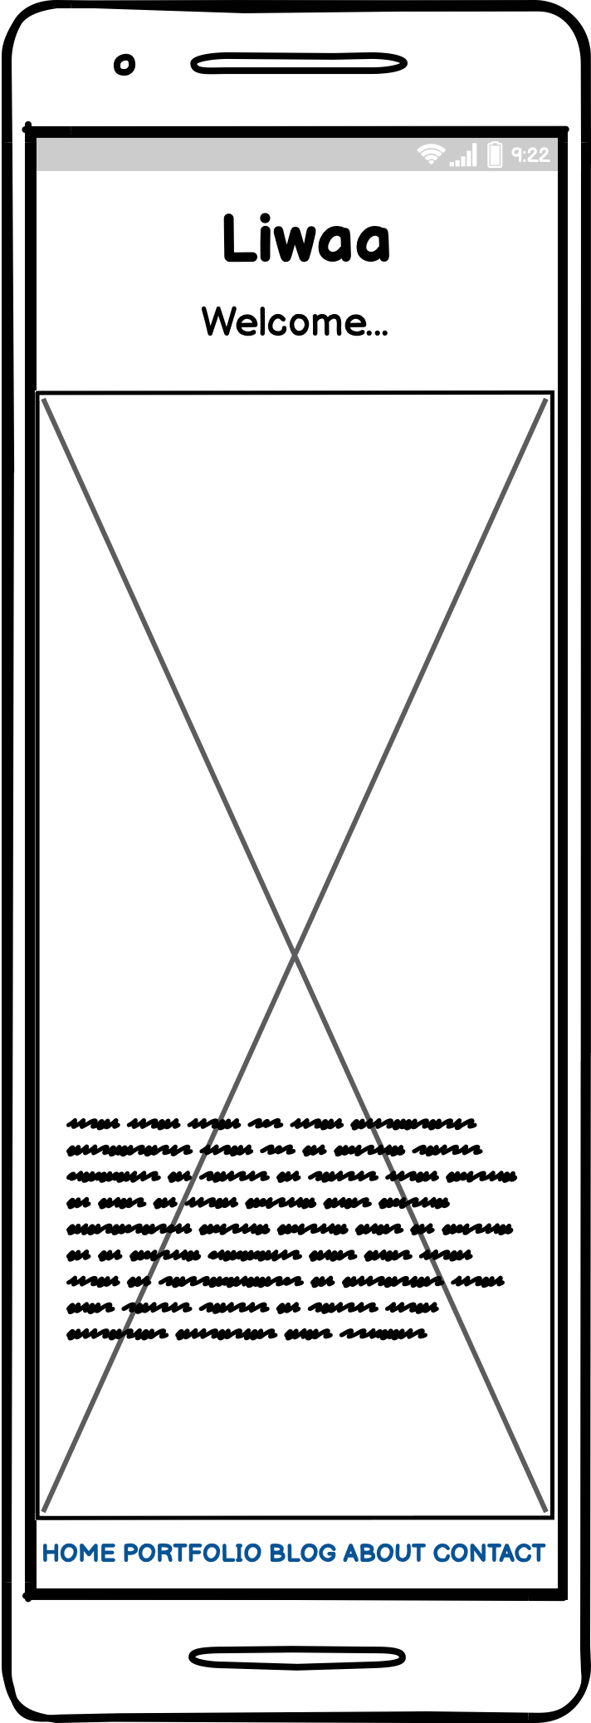
Wireframes of website
HOME PAGE

Slide 8

Wireframes of website
PORTFOLIO PAGE

Slide 9
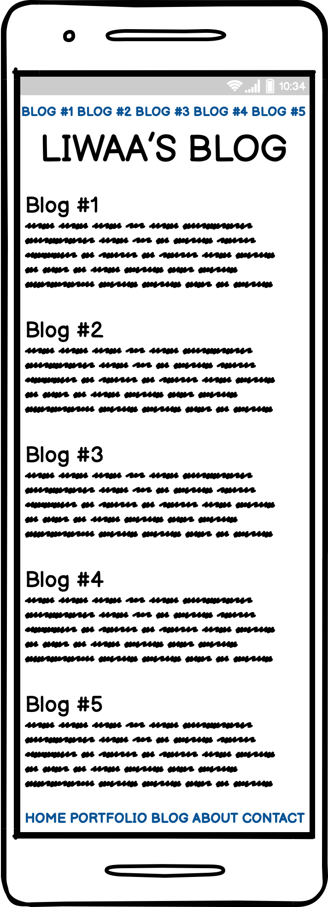
Wireframes of website
BLOG PAGE

Slide 10

Wireframes of website
ABOUT mE/CONTACT ME PAGE

Slide 11
Challenges I faced & The decision making process

Slide 12
THANK YOU FOR WATCHING!!

